Slide 1



Whole genome MLST: theory
Workshop: From Bacterial Genomics to Metagenomics
11-15 December 2017, University of Helsinki
João André Carriço,
Microbiology Institute and Instituto de Medicina Molecular,
Faculty of Medicine, University of Lisbon
jcarrico@fm.ul.pt twitter: @jacarrico

Slide 2
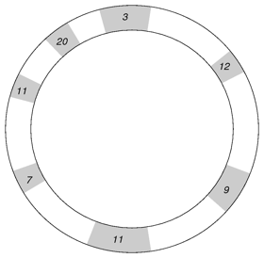

MLST MultiLocus Sequence Typing
?
ST | aroE | gdh | gki | recP | spi | xpt | ddl
156 | 7 | 11 | 10 | 1 | 6 | 8 | 1
1
?
xpt
recP
8
recP
spi
?
xpt
?
ddl
PCR
spi
6
1
ddl
aroE
gki
ST 156
?
?
gdh
?
7
aroE
gki
Sanger
Sequencing
?
10
Streptococcus pneumoniae
housekeeping genes
gdh
7 Sequences
11
www
Retrieve alleles and ST
http://pubmlst.org/spneumoniae/

Slide 3
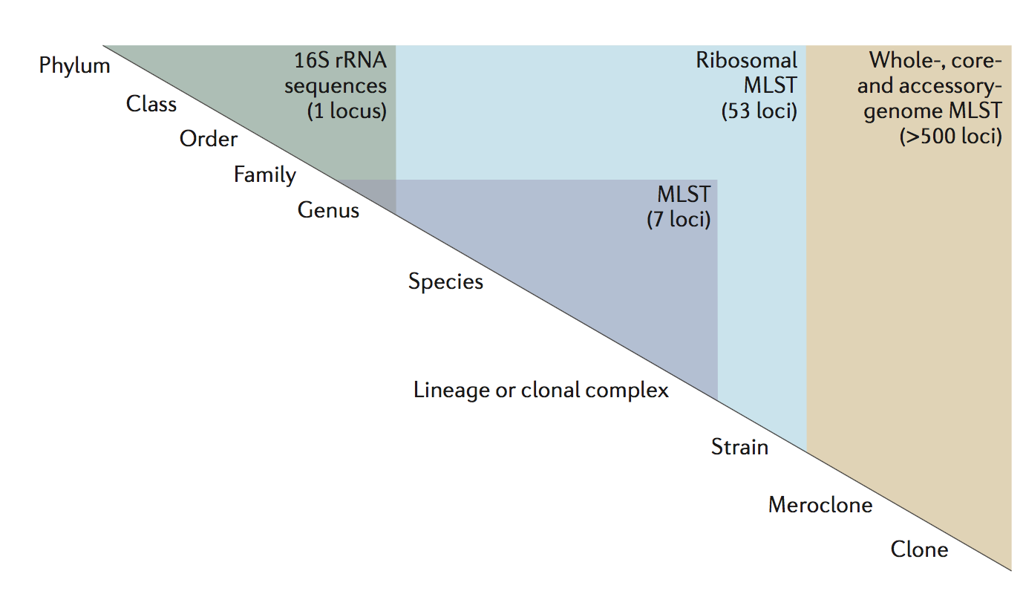
xMLST hierarchy
Maiden, M. C. J. et al. MLST revisited: the gene-by-gene approach to bacterial genomics. Nat Rev Micro 11, 728–736 (2013).

Slide 4
MLST vs cg/wgMLST

Slide 5
MLST technique
MLST – based on internal fragments of seven* housekeeping genes (~400-700 bp)
Housekeeping gene
MLST locus
Housekeeping genes : Present in all the strains
Locus Size : based on the PCR product size limitation
How to scale up to use draft genome data?
*in the great majority of current schemas

Slide 6
MLST vs cgMLST
MLST
cgMLST
# loci
7
Variable: depends on species and algorithm and parameters used
Coding Sequences (CDS) or gene fragments. No warranties on total recovery of loci due to experimental bias. Present in the majority of strains (95% ? )
Locus
definition
internal fragments of house keeping genes, defined by primers
Allele
definition
Sequence that matches a first allele in length and aligns to it. No similarity check performed
Sequence that passes a blast similarity threshold and a size threshold. Depends on the algorithm, locus definition and parameters.

Slide 7
Gene-by-gene approaches: cg/wgMLST
What is a wgMLST or a cgMLST schema?
What is a locus?
What is an allele ?
Notes:
JAC

Slide 8
wgMLST schemas
L0
L1
L2
L3
L4
L5
L6
L7
L8
L9
Strain 1
Strain 2
Genomes
Strain 3
Strain 4
Strain 5
Strain 6

Slide 9
Genomes and Loci
L0
L1
L2
L3
L4
L5
L6
L7
L8
L9
Strain 1
Strain 2
Strain 3
Strain 4
Strain 5
Strain 6

Slide 10
Genomes and Loci
L0
L1
L2
L3
L4
L5
L6
L7
L8
L9
Strain 1
Strain 2
Strain 3
Strain 4
Strain 5
Strain 6
Core Genome -> cgMLST
Accessory genome
Core Genome+ Accessory Genome = PanGenome -> wgMLST / pgMLST
….But what is a locus? How we define them and create a schema?

Slide 11
Defining Loci in a Schema
Starting with completely assembled genomes
and annotated draft genomes
GBK/ FASTA
file
CDS
CDS
CDS
CDS
CDS
CDS
CDS
CDS
CDS
BLAST
CDS
CDS
CDS
CDS
GBK/ FASTA
file
Core genome: CDS common to all
Accessory genome: CDS present in some
CDS
CDS
CDS
CDS
CDS
CDS
CDS
Other parameters:
Min locus size
Prodigal (Prokaryotic Dynamic Programming Gene finding Algorithm):

Slide 12
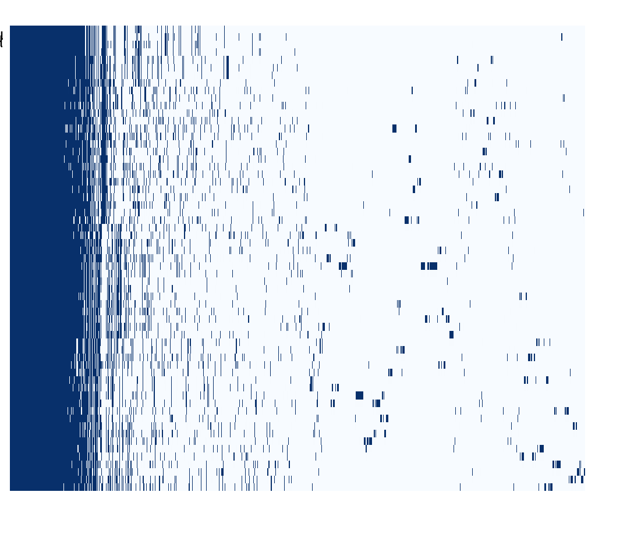

Gene-by-gene approaches : Challenges
Defining a schema: core vs accessory genome
Roary presence and absence matrix (10661 gene clusters)
BLAST / CD-HIT approaches to define the set of identical loci : Always dependent on thresholds and existing CDS annotation. Same for allele calling.
CDS s1
80%
60%
CDS s2
80%
CDS s3
Need for paralogous genes to be correctly identified
How to handle and analyze constantly growing DBs?
61 Streptococcus dysgalactiae subspecies equisimilis isolates
Software typically used:
OrthoMCL (http://orthomcl.org/) (Li L. Genome Research 2003)
CD-HIT (http://cd-hit.org.) (Fu L et al Bioinformatics 2012)
Notes:
JAC

Slide 13
Allele calling
Also BLAST based:
Blastn, blastp or blastxd
BLAST settings can change the results
BLAST matches need to be validated by a similarity threshold and size threshold

Slide 14
Gene-by-gene approaches: cg/wgMLST
Existing databases/software :
Non-commercial:
BIGSdb ( Jolley, K. A. & Maiden, M. C. J. BMC Bioinf 11, 595 (2010).) – www.pubmlst.org
Enterobase (https://enterobase.warwick.ac.uk/)
GEP (Genome Profiler) (JCM. 2015 May;53(5):1765-7)
Commercial:
Ridom Seqsphere+ (Ridom)
Bionumerics (Applied Maths)
Notes:
JAC

Slide 15
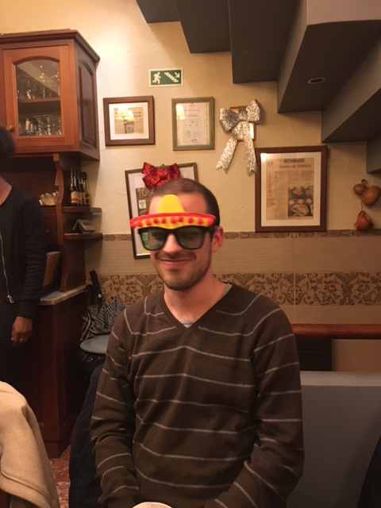
chewBBACA: BLAST score ratio Based Allele Calling
Our approach to the problem:
This is Chewbacca ... He is chewBBACA’s cousin
Mickael Silva
Notes:
JAC

Slide 16



Acknowledgments
INNUENDO project [GP/EFSA/AFSCO/2015/01/CT2]
BacGenTrack project [FCT / Scientific and Technological Research Council of Turkey (Türkiye Bilimsel ve Teknolojik Araştırma Kurumu, TÜBİTAK), TUBITAK/0004/2014]
ONEIDA project (LISBOA-01-0145-FEDER-016417) co-funded by FEEI - “Fundos Europeus Estruturais e de Investimento” from “Programa Operacional Regional Lisboa 2020" and by national funds from FCT - “Fundação para a Ciência e a Tecnologia”

